Slide 1
English Debates
1st Day

Slide 2
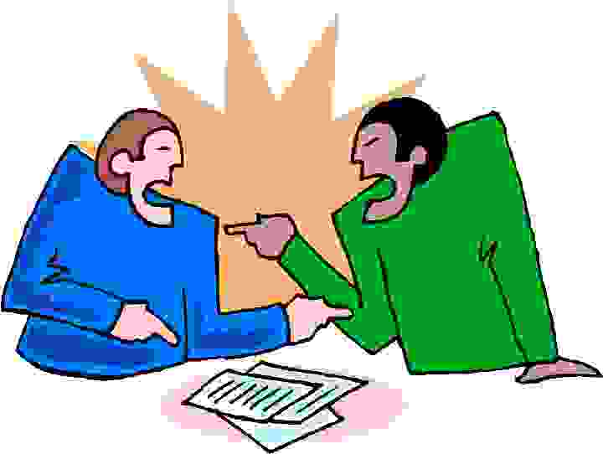
How to critique?

Slide 3

Warm-up Practice
Mina’s TOEIC score is 950. So, she must be very good at speaking English….
Do you agree?? Is this argument true and convincing??

Slide 4
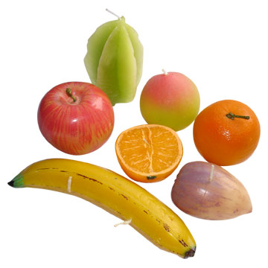
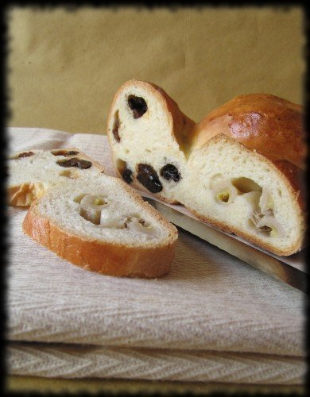
Argument 1
“We should eat bread and fruit every morning because four out of five doctors recommended this type of diet.”
Problems…??

Slide 5
Argument 1
“We should eat bread and fruit every morning because four out of five doctors recommended this type of diet.”
Evidence Problem
Evidence is weak….How about other evidence??

Slide 6
Example
Bread and fruit might be good for our breakfast. Four out of five doctors recommended eating bread and fruit every morning because this type of diet provides one adult person with sufficient nutrition for a day. For example, vitamin C makes you feel less tired.”

Slide 7
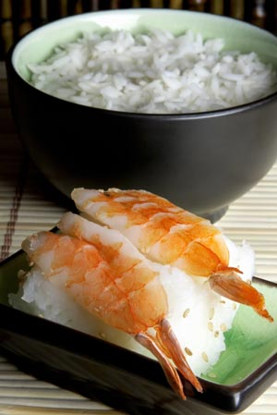
Argument 2
“Whenever I eat Japanese rice I have digestion problems. So, eating Japanese rice causes digestion problems.”
Problems…??

Slide 8
Argument 2
“Whenever I eat Japanese rice, I have digestion problems. So, eating Japanese rice causes digestion problems.”
Causality
When you DO NOT eat Japanese rice, do you still have digestion problems?
Does anything else cause digestion problems?

Slide 9
Example
“I love to eat rice and have tried many kinds of rice. But only when I eat Japanese rice, I always have digestion problems. I do not have any problems when I eat other kinds of rice such as Thai, Chinese, Indian and California rice. So, it might be good to avoid eating Japanese rice.”

Slide 10
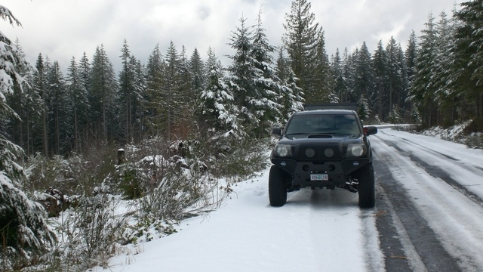
Argument 3
“ Ryan was able to drive his car well in the rain yesterday. So, he can drive his car in the snow without any problems.”
Problems…??

Slide 11
Argument 3
“ Ryan could drive his car well in the heavy rain yesterday. So, he can drive his car in the snow without any problems.”
Analogy
Analogies are not similar (driving in the heavy rain ≠ driving in the snow)

Slide 12
Example
“The heavy rain yesterday was really bad. But, Ryan drove the car very carefully and slowly. So, he might be able to drive in the snow because it requires a lot of attention to drive in the bad weather.”

Slide 13
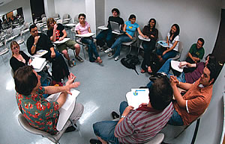
Debating

Slide 14
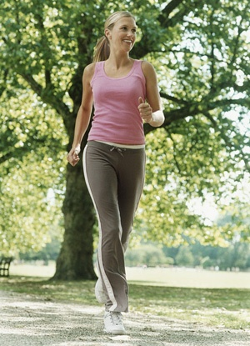
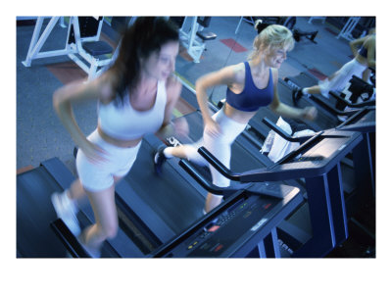
Topic
“Running inside is better than running outside”

Slide 15
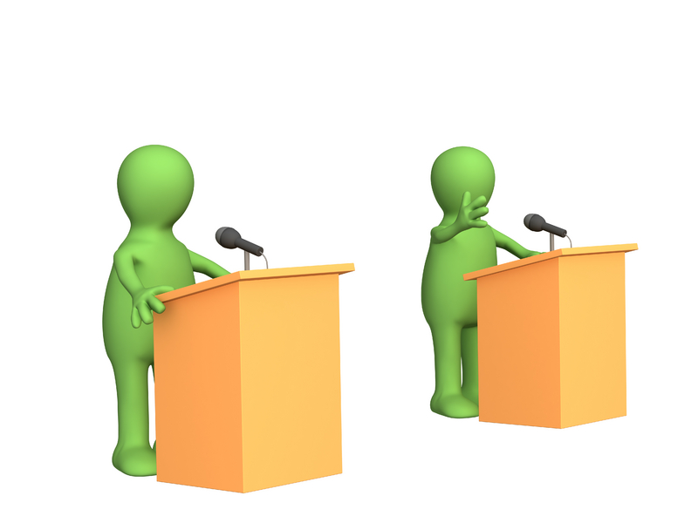
1. Divide into two teams!
Running OUTSIDE team
Running
INSIDE team
V.S.

Slide 16
2. Start debating!
I think that running inside is better because it is safe
1 point!

Slide 17
3. Corresponding!
It is safe, but it is very expensive to go to a gym. Running outside is free!
2 points!

Slide 18
4. Just adding a new opinion
It is refreshing to run outside!
1 point!

Slide 19
5. Pass!
………! I can’t come up with anything…..PASS!!!
0 points!

